Slide 1

HPE Technology and Solution Summit 2018
Kubernetes on HPE Synergy & Portworx
Prakash Mirji, Mar 2018
Notes:
When customers start to adopt containers, they would be looking for
Right infrastructure that is robust agility, speed, scale within on-prem environment
As organizations move to adopt containers and microservices, users are faced with what types of workloads to containerize and what types of containers to deploy in production. With the right infrastructure, stateful containers improve business agility and IT operational experience in the same manner as stateless container workloads. For enterprises, the benefits include enabling developer agility, improving resource usage, and more efficient scaling within IT managed environments.

Slide 2
Kubernetes on Synergy & Portworx
Platform for CaaS and DevOps Solution
March 2018
Prakash Mirji
Global Solution Engineering
Notes:
This is a session on container platform solution using Kubernetes.
Then problem : you get container services on cloud, but
When customers start to adopt containers, they would be looking for
Right infrastructure that is more suited for stateful
And that has benfits agility, speed, scale within on-prem environment
As organizations move to adopt containers and microservices, users are faced with what types of workloads to containerize and what types of containers to deploy in production. With the right infrastructure, stateful containers improve business agility and IT operational experience in the same manner as stateless container workloads. For enterprises, the benefits include enabling developer agility, improving resource usage, and more efficient scaling within IT managed environments.

Slide 3

Global Solutions Engineering Who we are….What we do?
Mission:
Be a strategic partner for our Geographies, BU’s and Partners in architecting customer-centric solutions to accelerate HPE growth.
Shared Field
Engineering
Last mile engineering - Remove technology inhibitors and overcome product gaps
‘First of a kind (FOAK)’ solution development for customers using HPE technology and build reusable solutions
Competitive attack and install base growth/retention initiatives
POC/Pilot engagements
Performance Engineering
Image courtesy: http://fireaviation.com/2015/09/22/forest-service-to-transition-to-ram-air-parachutes/
Notes:
Field Engineering –
OneView integration with customer ecosystem
OpenStack/Helion POC support
Cloud migrations
Custom solution development
Competitive and performance analysis tools (servers and storage)
Note: key “wrap around” services include Best Practice sharing/Knowledge Transfer, Global Program/Project Management and Region/BU Program Support (e.g. competitive, etc.)
Solutions Roadmap – being developed
Revenue Growth
Transform to solution selling, retain and expand our install base, with emerging technologies with better ROI to customers as well as HPE

Slide 4

Agenda
Overview
Sample microservices application
Architecture overview for container infra
Kubernetes overview
Why portworx
Solution Components
Demo Video
Summary | Q & A

Slide 5
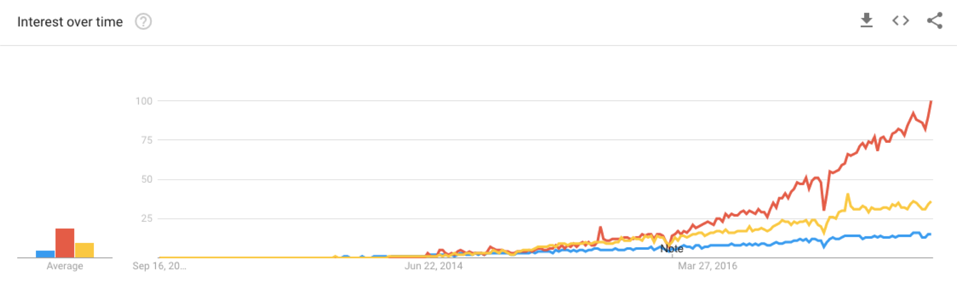
New IT Transformation Trend
2014
2016

Slide 6

Container Usage is Growing
$0.5B
$2.7B
2015
2020
Containers Market 5x in 5 years
Source: http://www.informationweek.com/cloud/infrastructure-as-a-service/451-research-containers-a-$2.7-billion-market-by-2020/d/d- id/1327868

Slide 7
Enterprises Want Container Workloads in Production
44%
27%
17%
Running
Today
Planning to Run
Within 1 year
Planning to Run
Within 2 yrs or more
Cloud Adoption Trends Driving IT Transformation Research Report, Insight Avenue, 2017
1412 IT decision makers in companies with 250+ employees, across all sectors, interviewed in 2017
(55% VP / C-level / Director level, 45% Senior Manager level)

Slide 8
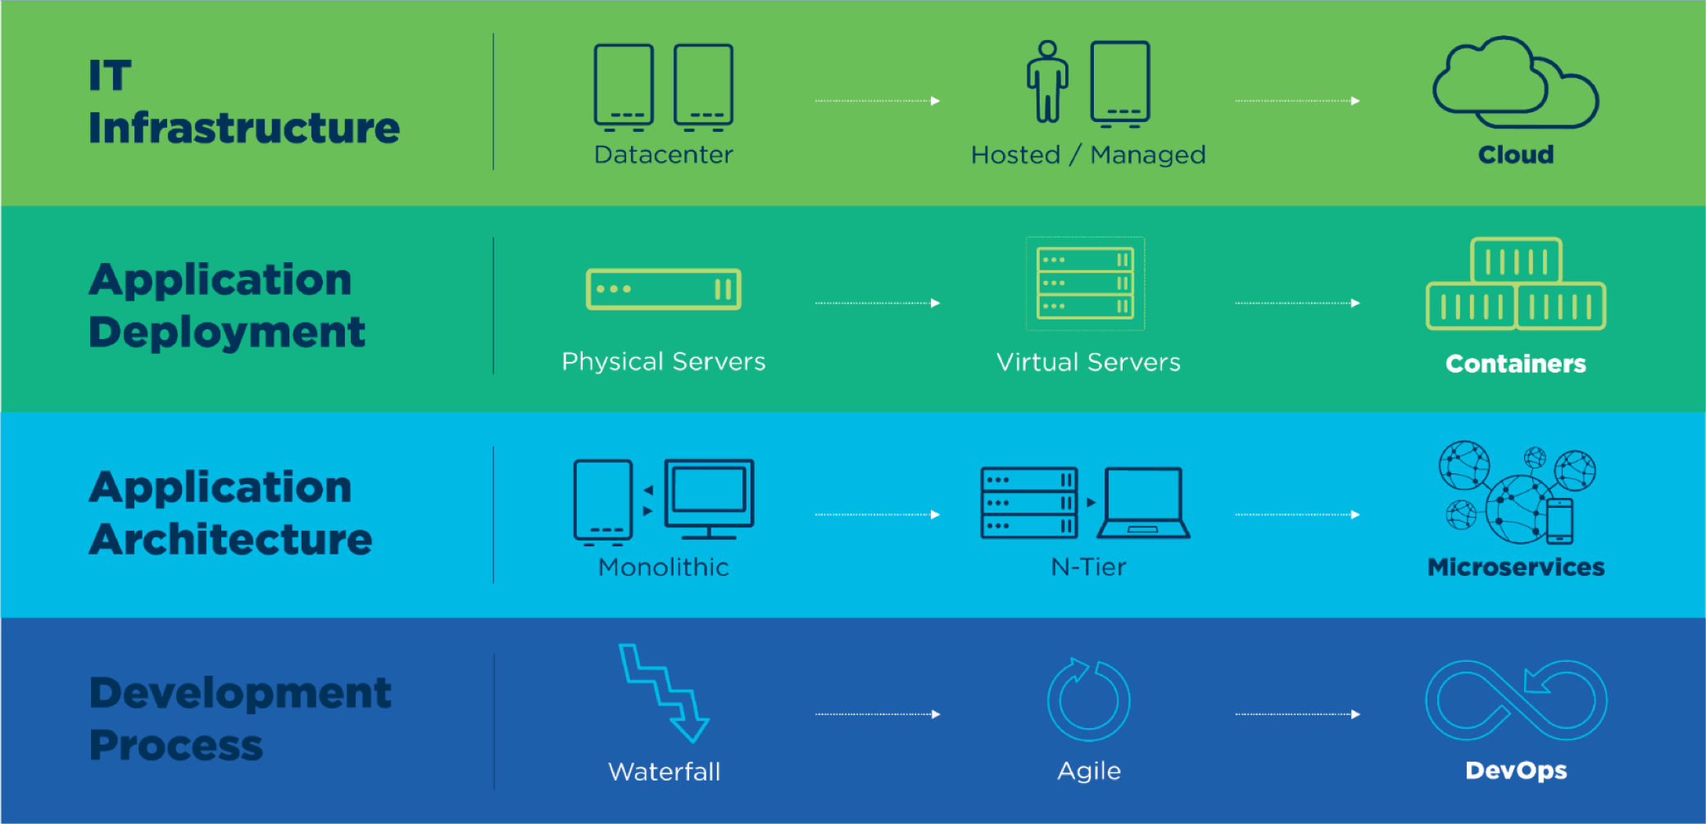
Changing Business Demands are Transforming IT
On HPE Synergy

Slide 9
Change in Apps Development and Deployment
Cloud based services and products
Google container service
AWS container service
Azure Kubernetes service
OpenShift
HPE on-prem solution
Kubernetes
Composable infrastructure
Microservices
Containers
Cloud Native Apps
API First
Always On App
Notes:
Mp3 evolution
Smartphone & digital
Similar phenomena happening for software application industry
With the evolution of microservices and containers in the recent years, the way
we design, develop and run software has changed significantly. The new modern
applications are optimized for scalability, elasticity, failure, and speed of change.
Driven by new principles, these modern architectures require a different set of
patterns and practices to be applied.
This session will provide architectural guidance for deploying, scaling, and managing stateful cloud-native applications with Kubernetes as a scale-out and efficient container orchestrator and Portworx PX-Enterprise edition as a cloud-native software-defined storage platform on HPE Synergy composable infrastructure. More specifically, it shows how to: • Deploy Container-as-a-Service (CaaS) and managed container functionality within IT organizations using Kubernetes as the orchestration engine • Run stateful workloads using Portworx PX-Enterprise as the cloud-native storage platform • Automate deployment and scale of an integrated Portworx + Kubernetes platform leveraging HPE Synergy strengths in rapid provisioning using HPE Synergy Image Streamer by orchestrating through Ansible.

Slide 10


Deploying at Scale Requires Automation
Orchestration
Scheduling
Service discovery
Performance and availability
Scaling
Load balancing
Self-healing
Monitoring
Maintenance
Rollout
Rollback

Slide 11



Organizations Need composable, scalable platform
Easier to get up and running quickly
On-prem solution with HPE Synergy platform
Robust, scalable, agile
Solution for stateful workloads
Manage with native K8s
Run stateful containers with Portworx

Slide 12

Building K8s manually can be difficult and time consuming
Image courtesy of google search

Slide 13
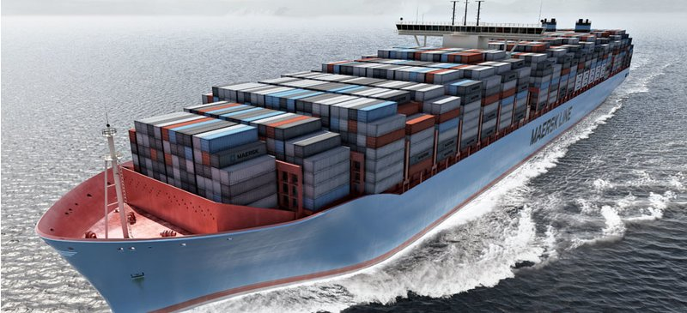
But with right architecture and tools – Building K8s can be made easy
Image courtesy of AT&T

Slide 14
Building K8s manually can be difficult and time consuming
Talks to google container platform
‘ok google’ scale my k8s cluster
ansible-playbook –v add_worker_nodes.yaml
Talks to OneView and Image Streamer
We treat “Synergy” as resource pool
Notes:
https://www.youtube.com/watch?v=07jq-5VbBVQ
Google say
Hardware is abstracted
Treat servers as resource pools
Synergy resource pool experience

Slide 15
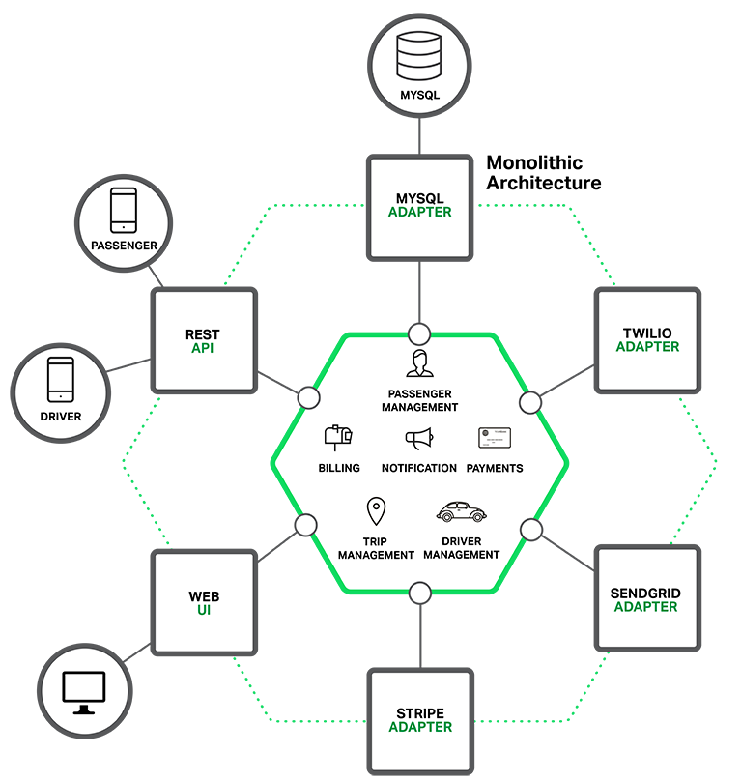
Sample Monolithic App

Slide 16
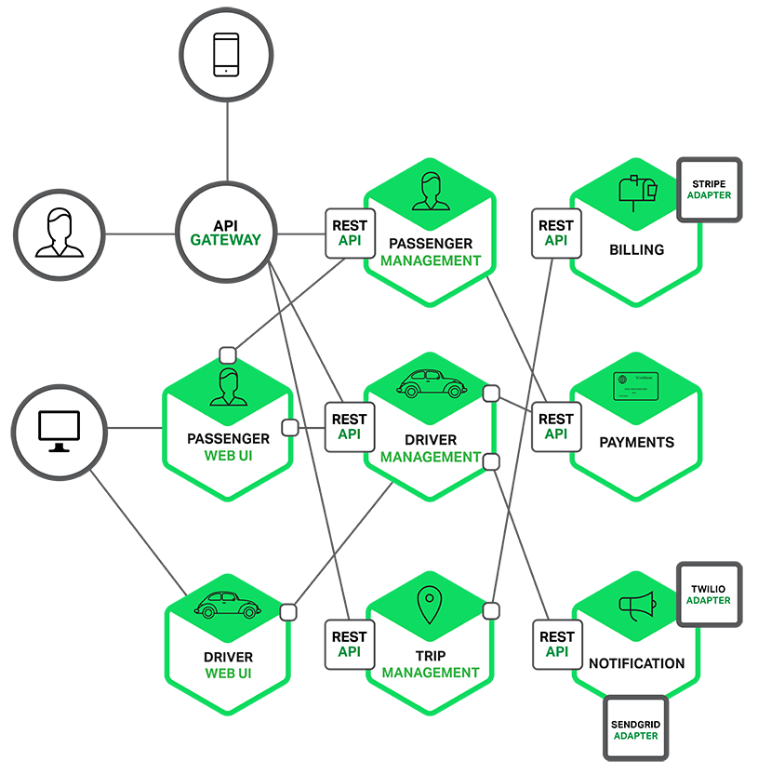
Decomposition of the Monolithic App to microservices

Slide 17
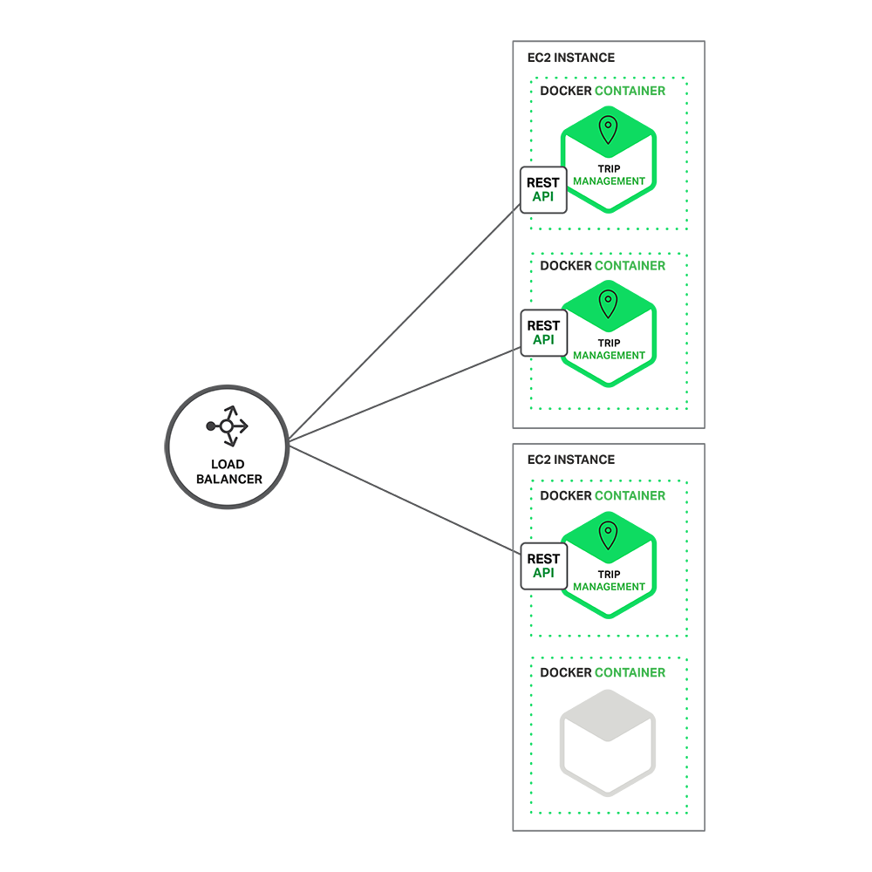
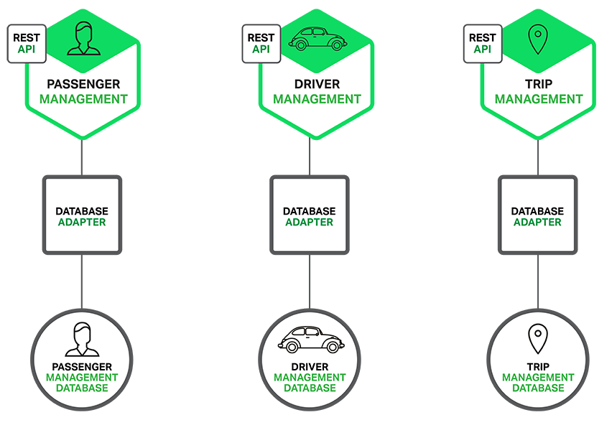
Showing scale and decentralizing the data (loose coupling)

Slide 18
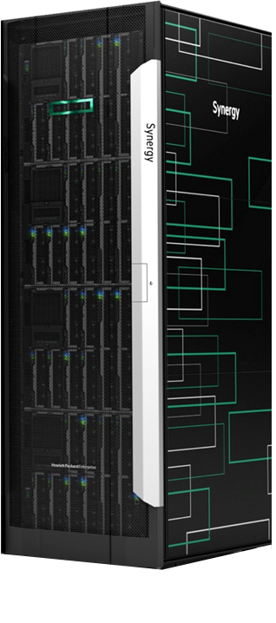
Platform for DevOps and Cloud native apps
HPE Synergy
Composable Infrastructure
Compute and Storage
Fabric
Rapid image-based deployment
Composer with embedded OneView
Image Streamer
Kubernetes
Portworx
Container Orchestration
Optimized container placement across a cluster of servers
Applications availability is managed
Built-in Services and Load Balancing
Services like IP addressing, DNS, and Load-balancing provided into apps
Self-healing
Containers replaced and rescheduled based on server and app-level checks
Elastic Container Storage
Increase number of stateful containers per server (example Cassandra rings)
Enables HA for any stateful application
Container Data Lifecycle Management
Volumes automatically get snapshots, encryption, and backup to object stores
Scheduler-complete Integration
Dynamic storage provisioning with automatic hyper-convergence
Notes:
Kubernetes is an open-source system for automating deployment, scaling, and management of containerized applications
Features:
Automatic binpacking,
Self-healing,
Horizontal scaling,
Service discovery and load balancing,
Automated rollouts and rollbacks,
Secret and configuration management
Storage orchestration
Batch execution

Slide 19
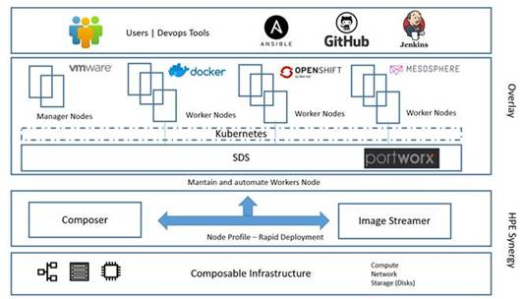
Architecture for CaaS (on-prem setup)

Slide 20
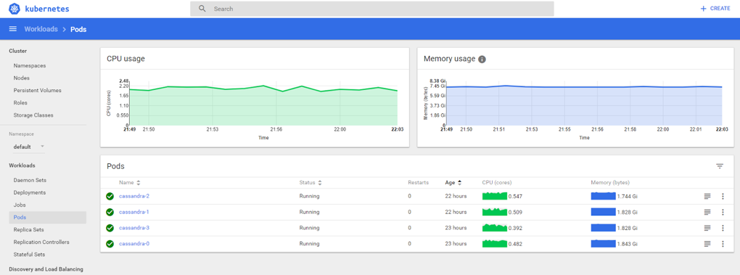
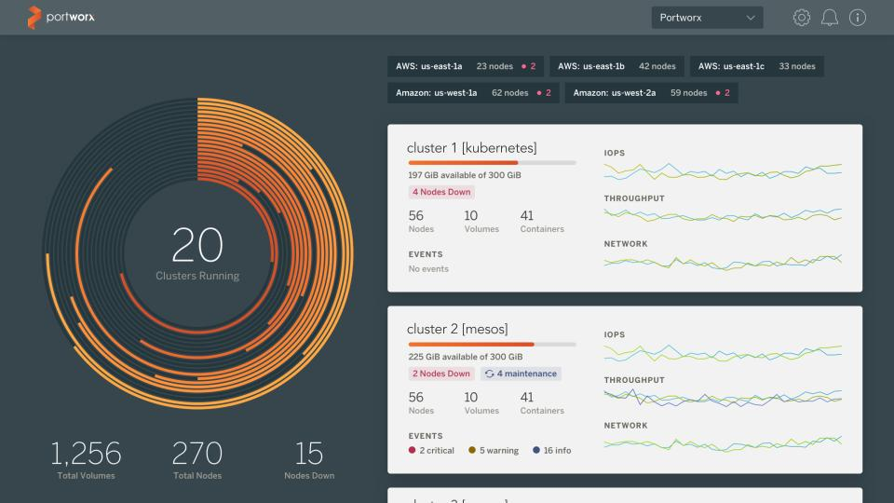
CaaS Dashboards
Cassandra deployed and managed as a StatefulSet and visible in the Kubernetes dashboard
Portworx volumes dynamically created with application deployments and visible from the management console
kublet
Docker
Cassandra-1
kublet
Docker
compute
Cassandra-1
Cassandra-1
kublet
Docker
compute
Cassandra-2
kube-proxy
compute
Cassandra-2
Kubernetes Worker Nodes
Every server is capable of running many Cassandra rings with compute containerization by Kubernetes and storage containerization by Portworx
kube-proxy
Cassandra-2
kube-proxy
Cassandra-3
PX-Enterprise
data
Cassandra-3
apps
PX-Enterprise
data
Cassandra-3
PX-Enterprise
data
apps
apps
Portworx + Kubernetes worker
(bare-metal on HPE Synergy 480 Gen10)
Portworx + Kubernetes worker
(bare-metal on HPE Synergy 480 Gen10)
Worker Nodes with Portworx + Kubernetes
(HPE Synergy 480 Gen10)

Slide 21
Kubernetes and Portworx configuration on HPE Synergy

Slide 22
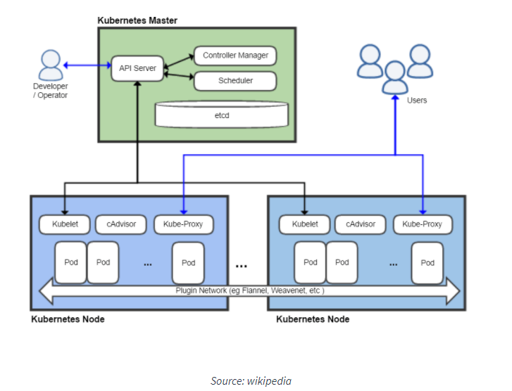
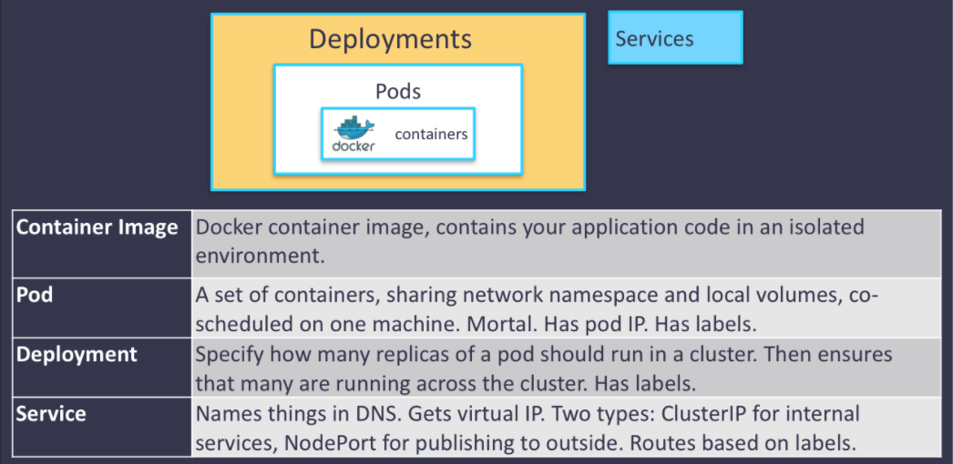
K8s Overview

Slide 23
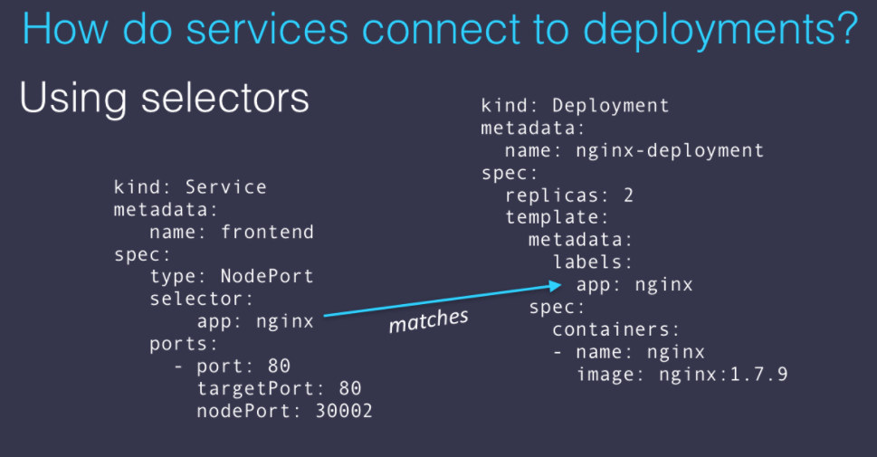
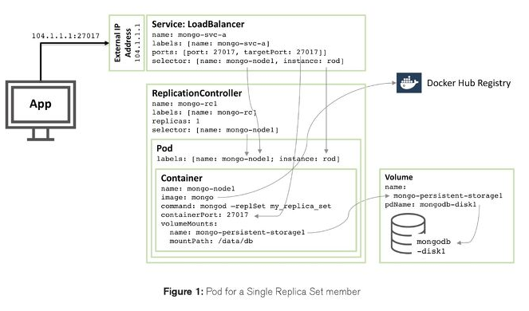
K8s Overview

Slide 24
Portworx is a distributed block-storage solution...
Distributed Block Storage
Notes:
Portworx is a distributed block storage solution

Slide 25

...that deeply integrates with any scheduler...
Deep Scheduler Intersection
DC/OS, k8s,
Docker ...
Notes:
That integrates with any scheduler- swarm, kubernetes, dcos-

Slide 26




...to run and manage any stateful service...
Any Stateful Service
DC/OS, k8s,
Docker ...
Notes:
To run and manage any stateful service - databses, queques, kv stores, cms, etc

Slide 27


...in any cloud or on-prem data center...
Any Cloud or Data Center
DC/OS, k8s,
Docker ...
On-prem Synergy
Notes:
in any cloud or on-prem data center

Slide 28
...across up to 1000 nodes
Up to 1000 nodes
DC/OS, k8s,
Docker ...
On-prem
Notes:
across up to 1000 nodes.

Slide 29
Why Portworx for k8s?
100% Cloud Native
Everything in Portworx is container-granular, everything configurable via API and CLI
Most production experience
GA for 18 months, users like GE, Verizon, Dreamworks running at scale
Scales to 1000 nodes today
Deep Kubernetes integration
Install and use all features directly via Kubectl
Application awareness to overcome k8s scheduling issues

Slide 30
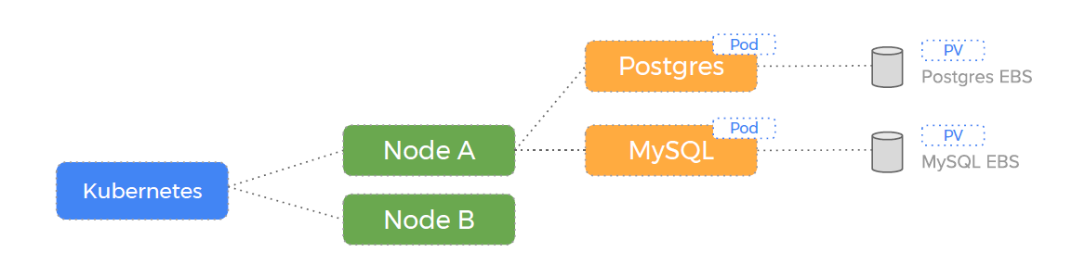
Node failover scenario with Portworx – before node failure

Slide 31
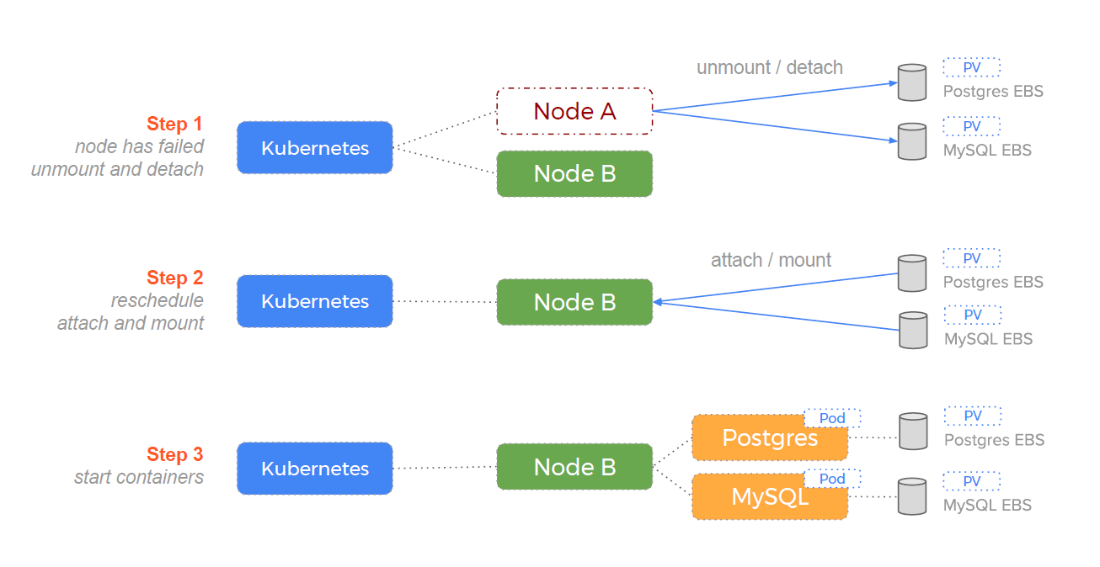
Node failover scenario with Portworx – after node failure

Slide 32
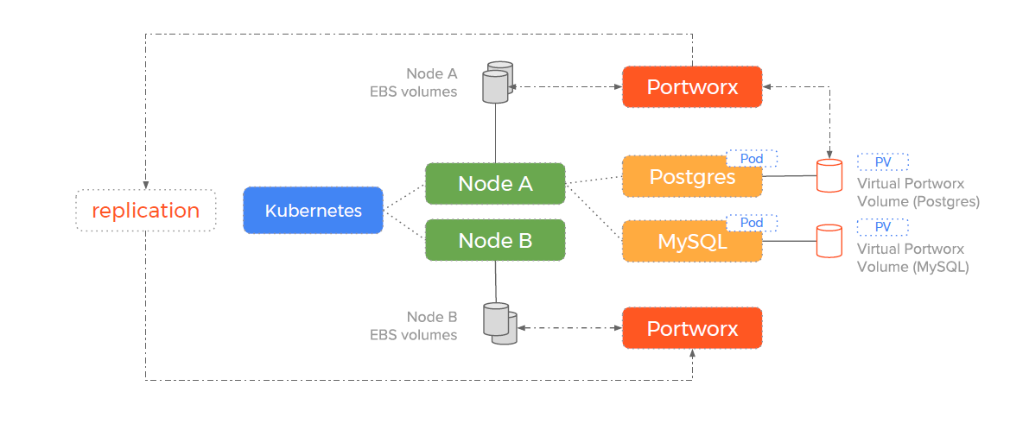
Portworx decouples the storage from the container
How drives are consumed when using Portworx

Slide 33
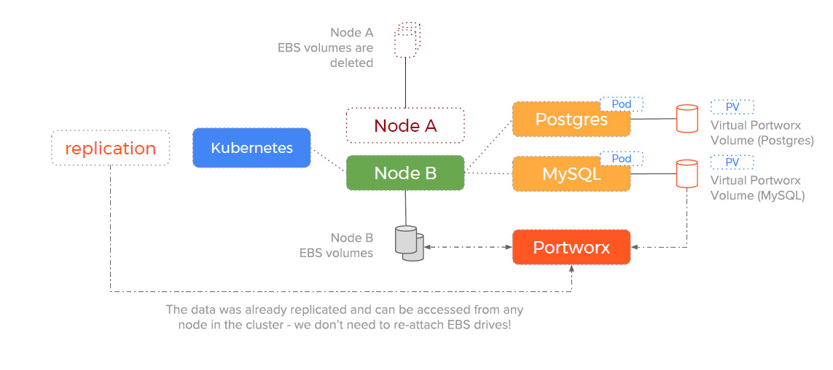
Portworx decouples the storage from the container
How Kubernetes handles a failover event when using a Portworx volume

Slide 34
Solution: Bootstrapping the deployment and demo

Slide 35
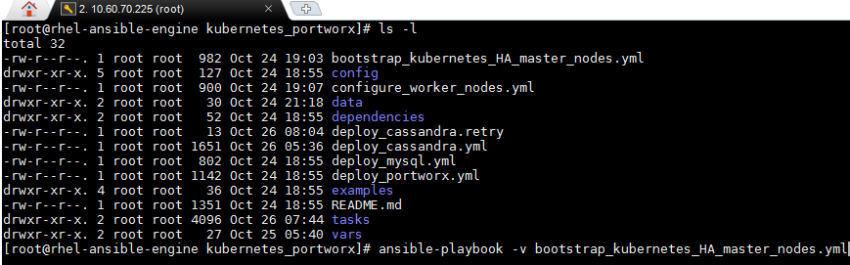
Bootstrapping Kubernetes HA Master Nodes on VMs
Script VM
API server
Automates master nodes deployment
compute
etcd
scheduler
compute
pod master
controller manager
data
apps
data
apps
Configures Docker and Kubernetes
kubelet
monit
Portworx + Kubernetes worker
(bare-metal on HPE Synergy 480 Gen10)
Kubernetes Master Node
(HA VMs on 480 Gen10)
Kubernetes HA Master Nodes
Ansible bootstraps master nodes, configures Docker and Kubernetes services. Configures load balancer and dashboard
Ansible bootstrap master nodes
Script VM
Bootstraps Kubernetes HA master nodes using Ansible playbooks

Slide 36
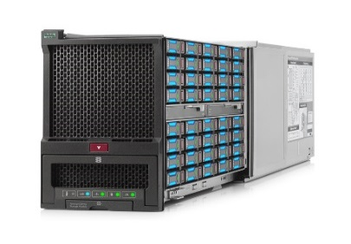
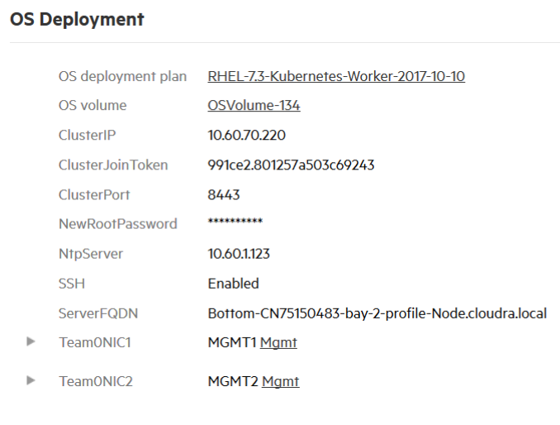
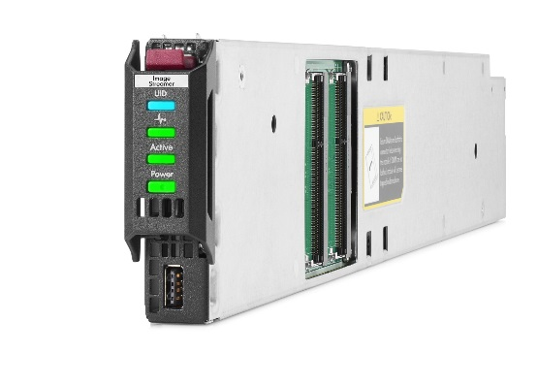
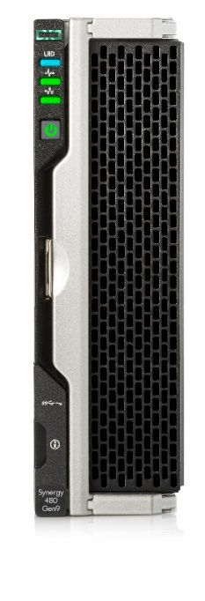
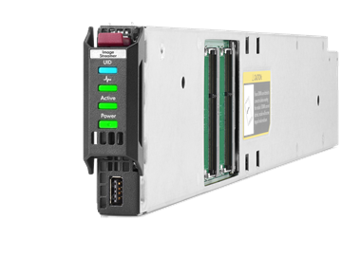
Bootstrapping the deployment of Kubernetes worker nodes on HPE Synergy
OS Image to Deploy
Block storage is presented to compute nodes. Portworx manages disks presented to nodes and provides container volume for running stateful apps
Initiates deployment plan
HPE Synergy D3940 Storage Module
Configures boot image
System configuration settings
Ansible
User triggers the ansible playbook
HPE Synergy Image Streamer
Creates bootable OS baked with Kubernetes services and Docker engine. Personalizes OS, Kubernetes and Docker per deployment plan
HPE Synergy Compute and Storage
Compute node boots directly into a running OS. Node joins automatically to Kubernetes and Portworx cluster
HPE OneView
Selects a deployment plan
Sets personalization parameters
Provisions physical infrastructure
Notes:
User triggers ansible playbook to provision worker nodes. Ansible talk to OneView to provision physical server with OS deployment.
OS deployment happens through Image Streamer

Slide 37
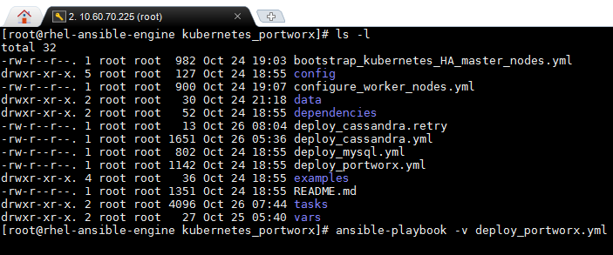
Automating the Deployment of Portworx on HPE Synergy
HPE Synergy D3940 Storage Module
Script VM
Automates installation of Portworx
Block storage is presented to computes nodes. Portworx manages disk presented to nodes and provides container volume for running stateful apps
Configures hardware for Portworx
Ansible installs Portworx
Kubernetes Worker Nodes
Nodes are assigned with disks from D3940
Ansible bootstraps Portworx installation
Portworx fingerprints the disks and creates the Portworx volume
Script VM
Bootstraps Portworx using Ansible playbooks

Slide 38
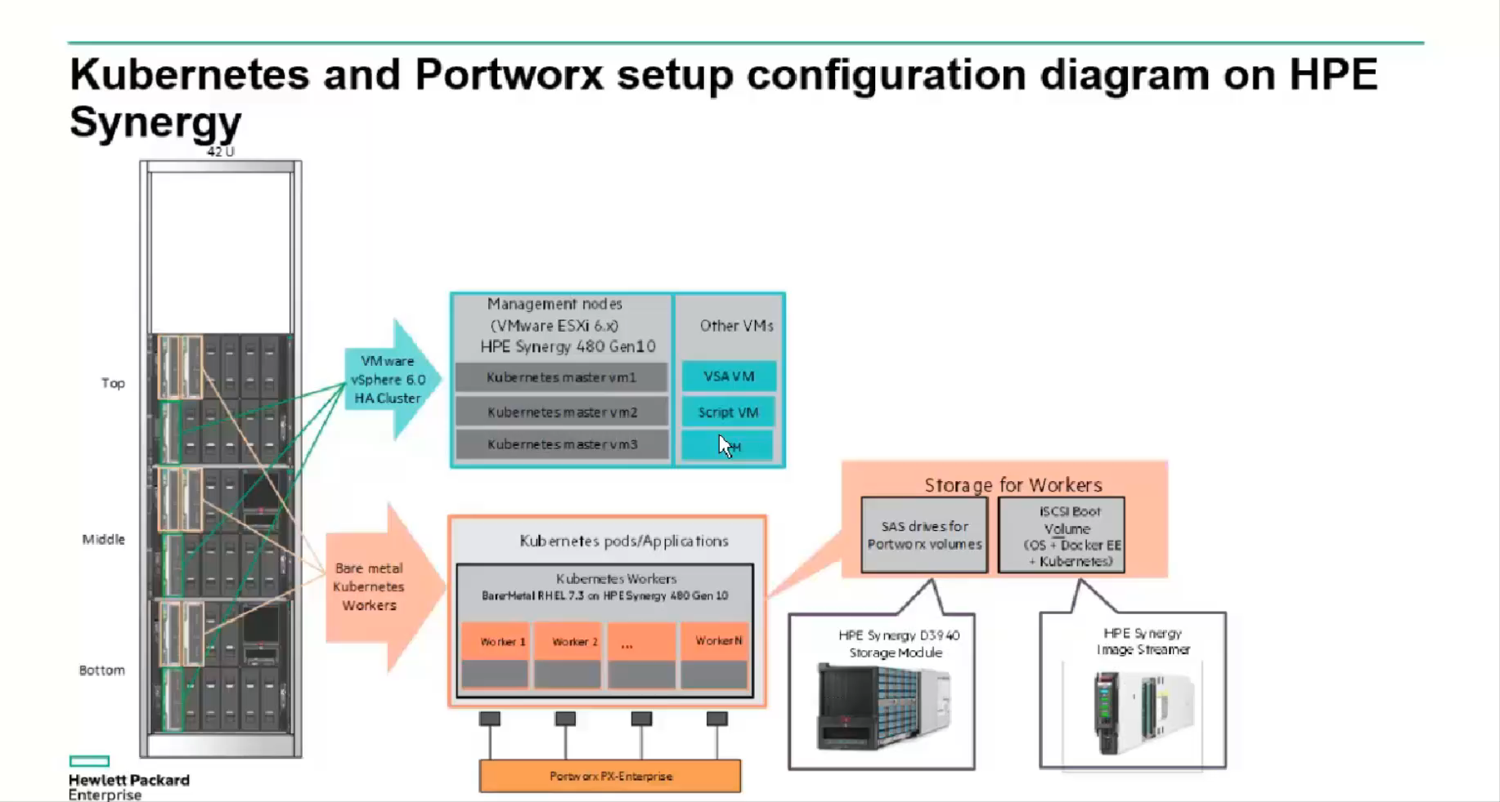
Demo
Demo

Slide 39
Takeaways
Right platform for hosting containers using Kubernetes
Scalable
Agile
Portworx is a good option for persistent container storage
On-prem CaaS solution on Synergy
Set up K8s infrastructure in less than an hour from ground up
Co-host non-container workloads on the same platform

Slide 40
For more information:
HPE Reference Configuration for Kubernetes, Portworx PX-Enterprise on HPE Synergy
https://h20195.www2.hpe.com/V2/GetDocument.aspx?docname=a00039700enw
GitHub link for Ansible integration
https://github.com/HewlettPackard/K8s-Portworx-Synergy
Kubernetes Persistent Storage on Portworx
https://portworx.com/use-case/kubernetes-storage/
Docker Storage on Portworx
https://portworx.com/use-case/docker-persistent-storage/
Persistent Storage for DC/OS on Portworx
https://portworx.com/use-case/persistent-storage-dcos/

Slide 41
Backup Slides

Slide 42

12
Container management platforms must also be
Composed
Secured
Hardened
Supported
Installed
Operated
Scaled
Maintained

Slide 43

13
“Building a container stack from the ground up is not for everyone.”
Container Services in the Public Cloud. Gartner 2017

Slide 44
Agenda
Need for container platform
Sample microservices application
Architecture overview for container platform
K8s overview
Why Portworx
Solution components
Demo video
Summary

